Slide 1
Ideal and real gases
Dr.Joseph Daniel
Associate Professor
SMBS
VIT

Slide 2
The concept of ideal gas
An ideal gas or simple a perfect gas has no intermolecular forces of attraction or repulsion.
It does not change its phase during a thermodynamic process.
Obeys a set of common rules governing change of its properties.
P=f(v,T) , it implies that when a substance is in a gaseous state it experiences appreciable changes in specific volume with changes in temperature and pressure.

Slide 3
It is a theoretical gas. Non existent
Atoms are specified by point particles with no volume.
Obeys ideal gas law, PV=nRT
Some gases like air, nitrogen, oxygen, hydrogen can be treated as ideal gas.
A gas behaves like an ideal gas…. When?

Slide 4
A gas behaves like an ideal gas at higher temperatures and lower densities.
At these conditions the intermolecular forces of attraction is of least significance.
Ideal gas model fails at lower temperatures and higher pressures when intermolecular forces are of worthwhile consideration.

Slide 5
Three basic classes of ideal gas
Classical Boltzmann-Maxwell ideal gas
Bose gas (Bosons)
Fermi gas (Fermions)

Slide 6
Physical Characteristics of Gases
Physical Characteristics | Typical Units
Volume, V | liters (L)
Pressure, P | atmosphere (1 atm = 1.015x10⁵ N/m²)
Temperature, T | Kelvin (K)
Number of atoms or molecules, n | mole (1 mol = 6.022x10²³ atoms or molecules)

Slide 7
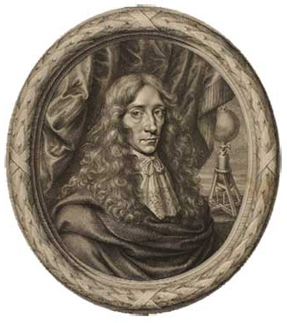
Boyle’s Law
Pressure and volume are inversely related at constant temperature.
PV = K
As one goes up, the other goes down.
P₁V₁ = P₂V₂
“Father of Modern Chemistry”
Robert Boyle
Chemist & Natural Philosopher
Listmore, Ireland
January 25, 1627 – December 30, 1690

Slide 8
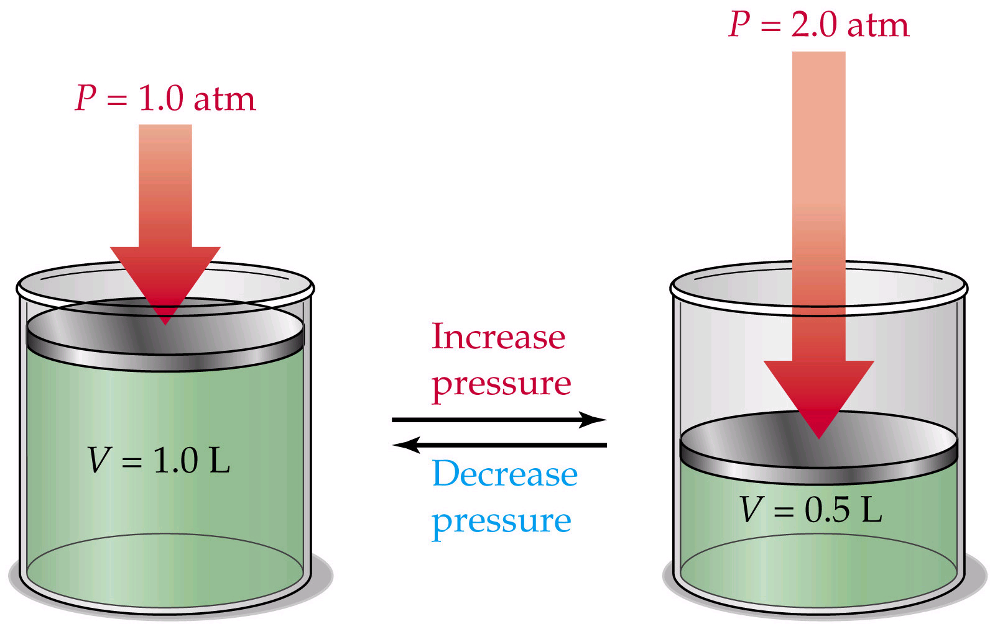
Boyle’s Law: P₁V₁ = P₂V₂

Slide 9
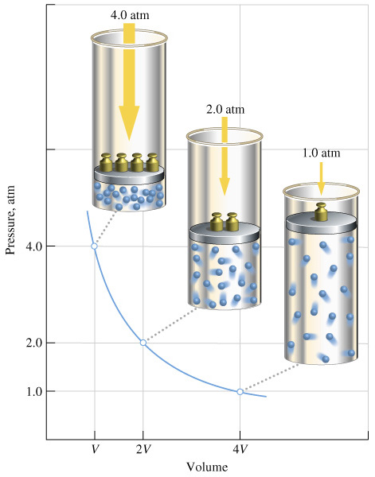
Boyle’s Law: P₁V₁ = P₂V₂

Slide 10
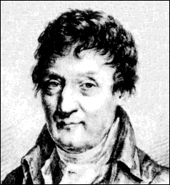
Charles’ Law
Volume of a gas varies directly with the absolute temperature at constant pressure.
V = KT
V₁ / T₁ = V₂ / T₂
Jacques-Alexandre Charles
Mathematician, Physicist, Inventor
Beaugency, France
November 12, 1746 – April 7, 1823

Slide 11
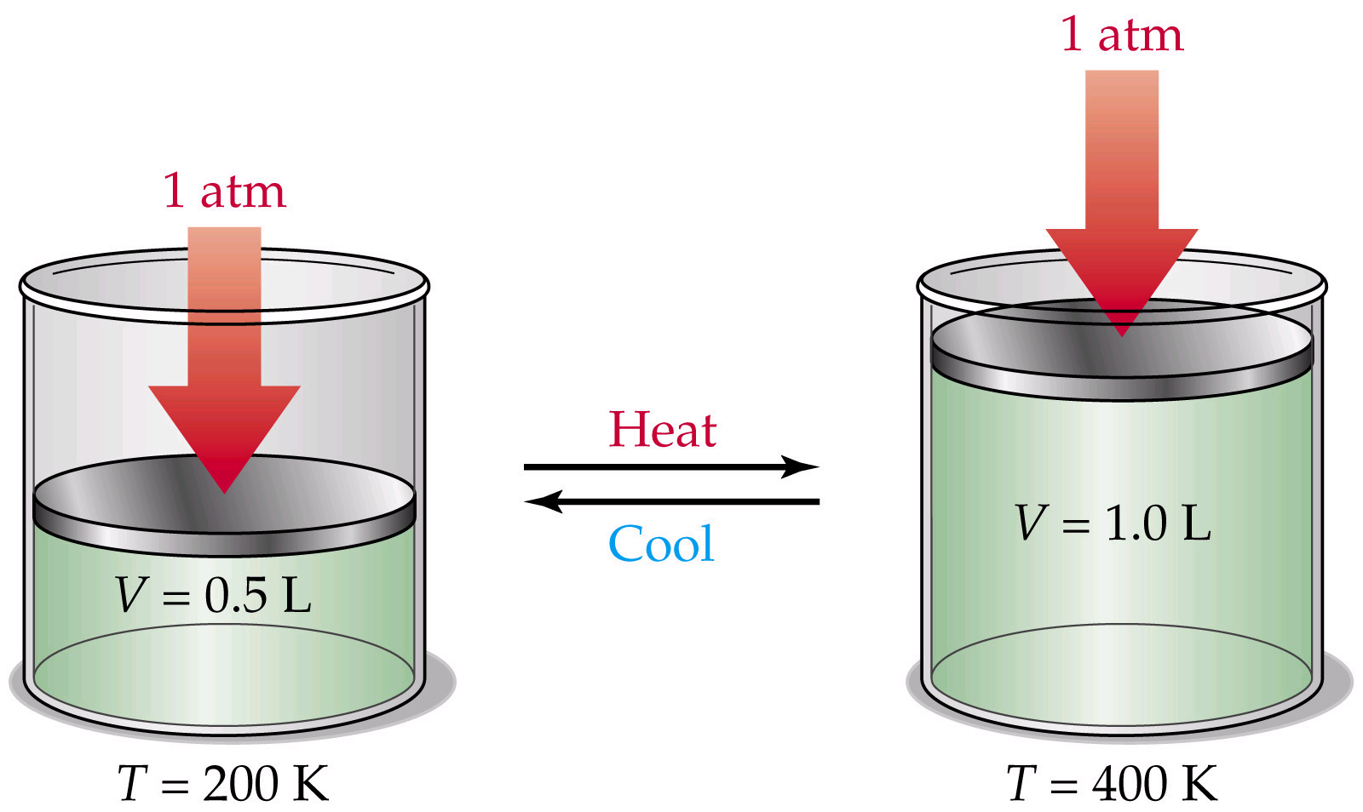
Charles’ Law: V₁/T₁ = V₂/T₂

Slide 12
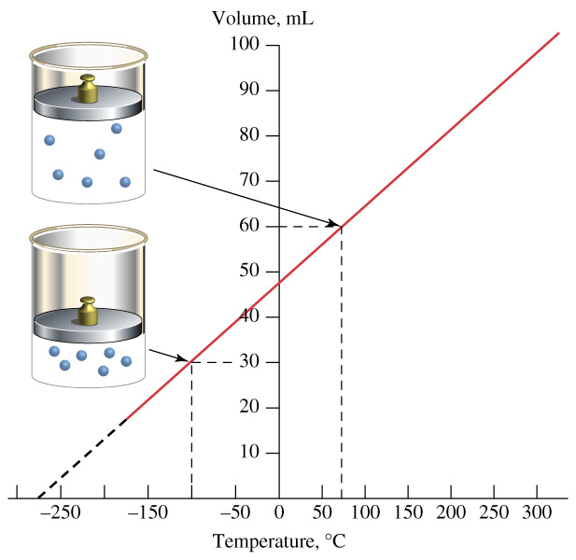
Charles’ Law: V₁/T₁ = V₂/T₂

Slide 13

Combining the laws yields
PV=nRT
R is gas constant 8.314 J/kg Mole.K or
The ideal gas equation of state is used when
(1) the pressure is small compared to the critical pressure
(2) when the temperature is twice the critical temperature and the pressure is less than 10 times the critical pressure. The critical point is that state where there is an instantaneous change from the liquid phase to the vapor phase for a substance.

Slide 14
Gas constant
Determine the particular gas constant for air and hydrogen.

Slide 15
Real Gases
A real gas is the one where properties that cannot be determined by the ideal gas model.
Compressibility effects, specific heat capacities, Van der Waal forces, non equilibrium thermodynamic effects play a part in the real gas model.
Different models of ideal gases are available with thermodynamic points of view

Slide 16
A comparision
Ideal Gas | Real Gas
Made of small particles having mass | Same
Empty spaces | Same
Low density | Same
Constant random straight line motion | Same
No attractive repulsive forces between particles | Small attractive forces exist
Particles have no volume | Small Volume
Collisions are elastic | Inelastic (when particles collide they lose energy)

Slide 17
Some Models
Van der Waals model
Berthelet Model
Redlich Kwang model
Beattie-Bridgemann model
Benedict-Webb-Rubin model
Strobridge model
Virial

Slide 18





Redlich Kwong and Berthelot models
[edit]

Slide 19


Van der Waal
Intermolecular forces of attraction
Volume occupied by the molecules themselves

Slide 20





Dietricei and Clausius model

Slide 21
Reduced Equation of state
Van der Waals equation of state in terms of reduced parameters
Reduced parameters: The ratio of the property of the substance at the given state to the value of the same property at critical state of the substance.
Critical point is the end point of a phase equilibrium curve
T_{r}=T/T_{c}, P_{r} = P/P_{c} and v_{r}=v/v_{c}
(P+a/v²)(v-b) = RT
Substituting T=T_{c}T_{r}, P=P_{c}P_{r} and v=v_{c}v_{r}
At p_{c}=a/27b², v_{c}=3b and T_{c}= 8a/27Rb yields
(pr+3/v_{r}²)(3v_{r}-1) = 8 T_{r}

Slide 22
Compressibility factor
Compressibility factor ‘Z’ is the ratio of actual volume of the gas to the volume predicted by the ideal gas equation at the same temperature and pressure.
Compression factor or gas deviation factor.
In other words pure gases under same reduced pressure and temperature have the same compressibility factor.
Z= v/(RT/p) or pv = ZRT
Z is dimensionless and approaches unity at ideal gas at all temperatures and pressures.
The magnitude of Z for a certain gas at a particular temperature and pressure gives an indication of the extent up to which a gas deviates from the ideal gas behaviour.
Z=f(p,T)

Slide 23
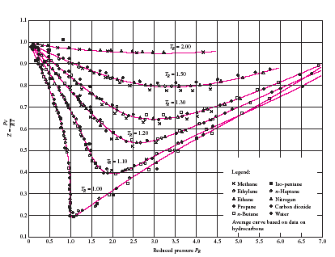
Compressibility factor for various gases

Slide 24
It is known from the compressibility chart that
Different chart is needed for each gases
As pressure is reduced the compressibility of gases approaches unity. Gases behaves more or less perfect gases when pressures are reduced.
The deviation of gas from ideal gas is greatest at the vicinity of the critical point.

Slide 25
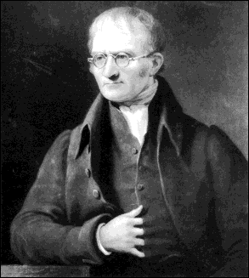
Dalton’s Law of Partial Pressure
The pressure exerted by all the moles of a gas in a gas mixture in the total volume (as if the other gases are absent) at the mixture temperature is defined as Partial Pressure
Ideal gas equation for a gas mixture is
PV = nR_{u}T (1)
And for the gas species ‘i’ in the mixture
P_{i}V = n_{i}R_{u}T (2)
Dividing (2) with (1),
John Dalton
Chemist & Physicist
Eaglesfield, Cumberland, England
September 6, 1766 – July 27, 1844

Slide 26
Dalton’s Law of Partial Pressure…
∴p_{i} = y_{i}P
For the gas mixture containing species 1,2,3,…n
p₁ + p₂ + p₃ + … + p_{n} = y₁P + y₂P + y₃P +…+ y_{n}P
= (y₁ + y₂ + y₃ + …+ y_{n})P
But
y₁ + y₂ + y₃ + … + y_{n} = 1
∴ p₁ + p₂ + p₃ + … + p_{n} = P
Dalton’s Law of Partial Pressure: The sum of partial pressures of gases in a mixture is equal to the total gas pressure

Slide 27
Amagat’s Law
The volume occupied by the moles of a gas in a gas mixture at the total pressure (as if the other gases are absent) and temperature is defined as partial volume
Ideal gas equation for a gas mixture is
PV = nR_{u}T (1)
And for the gas species ‘i’ in the mixture
PV_{i} = n_{i}R_{u}T (2)
Dividing (2) with (1),

Slide 28
Amagat’s Law…
∴ Volume fraction and mole fraction of a gas species in a gas mixture are one and the same
∴V_{i} = y_{i}V
For the gas mixture containing species 1,2,3,…n
v₁ + v₂ + v₃ + … + v_{n} = y₁V + y₂V + y₃V +…+ y_{n}V
= (y₁ + y₂ + y₃ + …+ y_{n})V
But
y₁ + y₂ + y₃ + … + y_{n} = 1
v₁ + v₂ + v₃ + … + v_{n} = V
Amagat’s Law: The sum of partial volumes of gases in a mixture is equal to the total gas volume

Slide 29
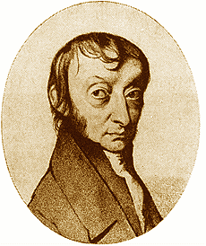
Avogadro’s Law
Under identical conditions of temperature and pressure, equal volumes of all gases have same number of molecules.
Mass of a gas = number of moles x Molecular mass
Density of gas1/density of gas 2 = (Molecular mass of gas 1/Molecular mass of gas 2)
Specific volume of gas 2/sp.vol of gas 1=(Molecular mass of gas 1/Molecular mass of gas2)
Amedeo Avogadro
Physicist
Turin, Italy
August 9, 1776 – July 9, 1856

Slide 30
A vessel of 2.75 m³ capacity contains 5 kg of oxygen at 300K. Determine the pressure exerted by oxygen using van der Waals equation. Compare the results if oxygen is treated as an ideal gas. The constants a = 139.35x10³ Nm⁴/(kg mol)² and b = 0.0314 m³/kg mol.
Volume occupied by 1 kg mole of oxygen = (2.75/5)*32 = 17.6 m³

Slide 31
Van der Waal equation of state
(p+a/v²)(v-b) = RT
p =(RT/v-b)-(a/v²).
p = (8314*300/(17.6-0.0314))-(139.35*10³)/(17.6)²

